Slide 1

SIOUX PARKING SYSTEM FINAL DEMO
Group Enigma
Brian Onuoha
Rick van Ham
Ebowusim Michael
Luc Moonen
Cristin Rusnac

Slide 2
Outline
PROJECT DESCRIPTION
CHALLENGES
DEMONSTRATION
CONCLUSION
QUESTION/REMARKS

Slide 3
PROJECT DESCRIPTION
The goal of the assignment is to develop a parking system that would manage the intake of SIOUX Technologies clients that come by car and would forward them to the reliable and available parking area.

Slide 4
CHALLENGES
License Plate Recognition
DATABASE
Proper Libraries
GIT Merges

Slide 5
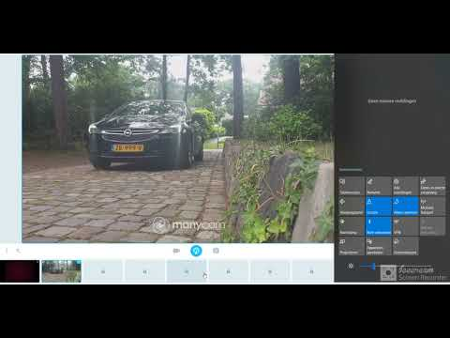
demo

Slide 6

CONCLUSION & Reflections
Communication
Features choice
Teamwork
Time management
Feedback

Slide 7
Questions?
<< Thanks for Listening >>>

